Slide 1
Co-operative Education Program
Elvira Sagyntay kyzy, Coordinator of Co-operative Education Program, Kyrgyzstan
elvira.sagyntay@ucentralasia.org
2019

Slide 2
Founded in 2000 under International Treaty between Governments of Tajikistan, Kyrgyz Republic, Kazakhstan and Ismaili Imamat and registered with UN
Secular, autonomous, not-for-profit, institution
First regional university, with campuses in three States, a range of programmes in Central Asia and Afghanistan
2

Slide 3
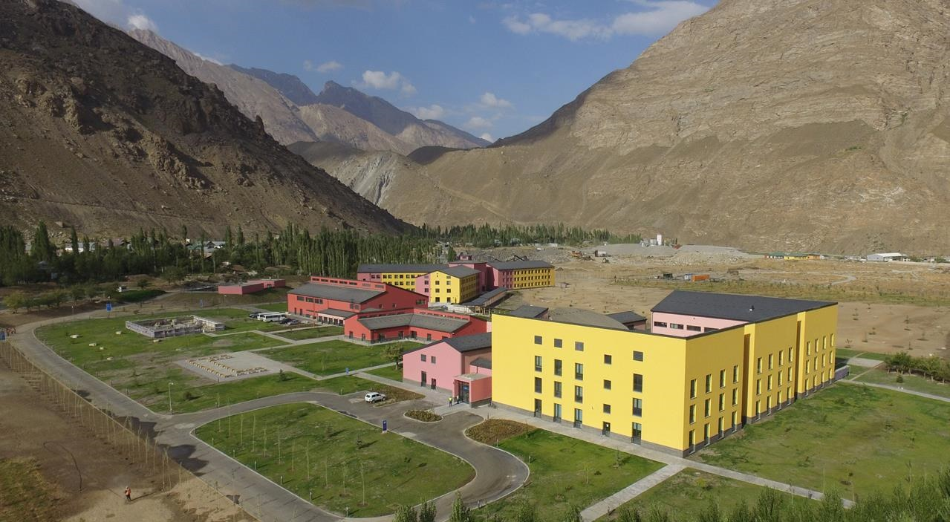
Khorog Campus
3

Slide 4
One University – Three Schools
School of Arts and Sciences
Graduate School of Development
School of Professional and Continuing Education
Naryn Campus
Institute of Public Policy and Administration
Tajikistan (4)
Khorog Campus
Mountain Societies Research Institute
Kyrgyzstan (2)
Tekeli Campus
Cultural Heritage and Humanities Unit
Kazakhstan (1)
Afghanistan (4)
4
Notes:
AKDN Organisation Chart

Slide 5
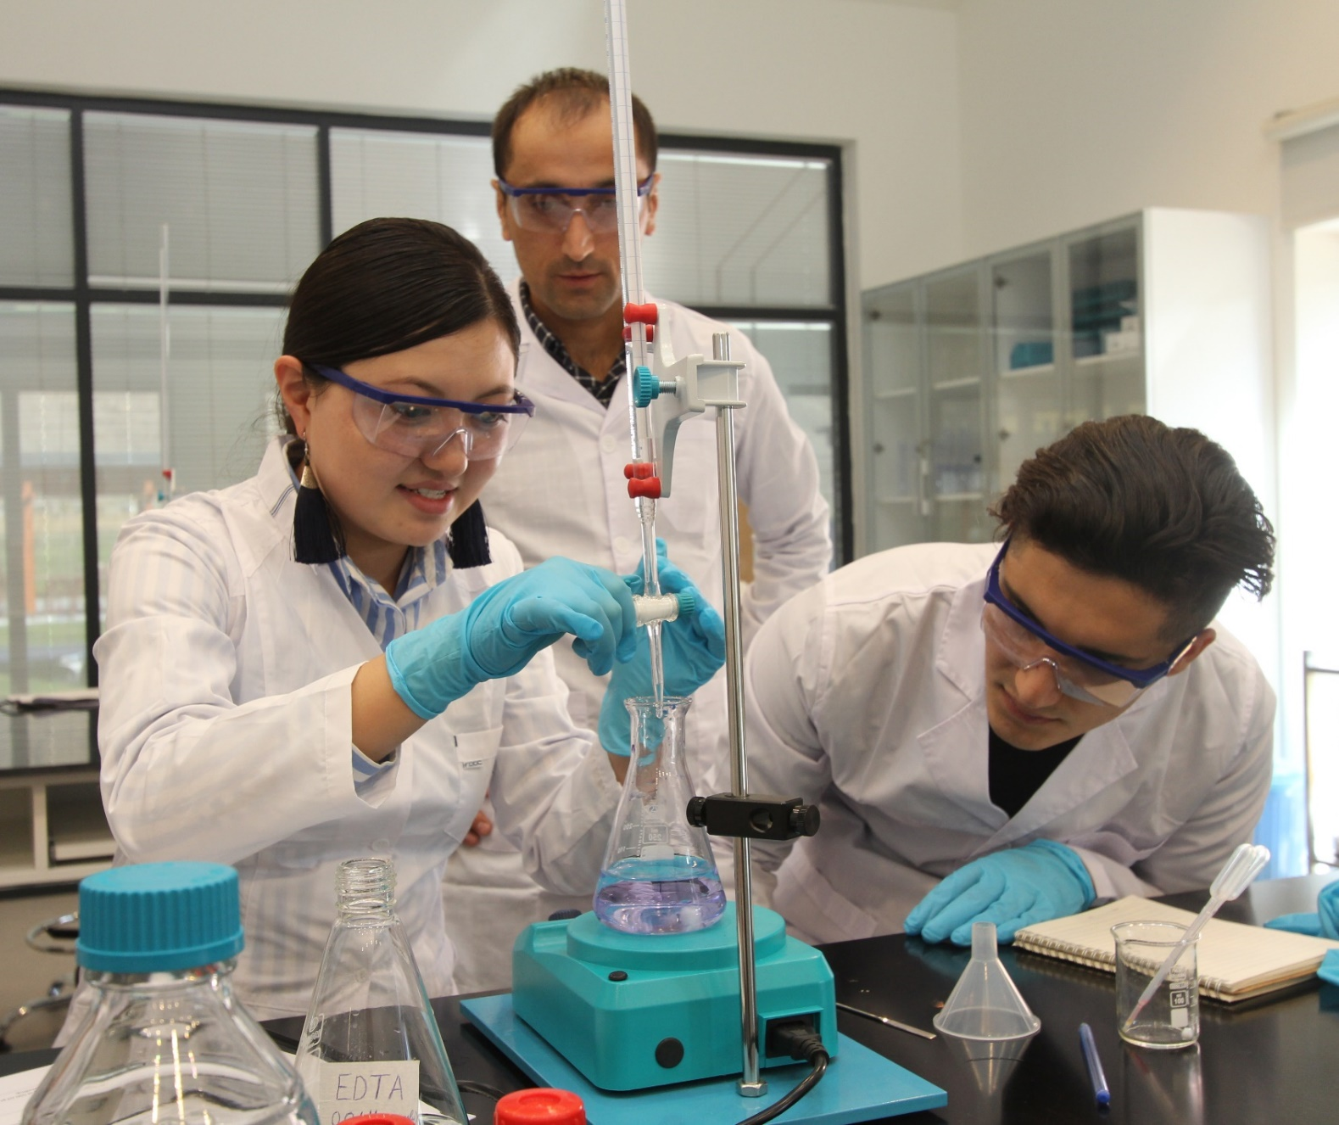
School of Arts and Sciences
Naryn, Kyrgyzstan
Communications & Media, BA
Computer Science, BSc
Khorog, Tajikistan
Economics, BA
Earth & Environmental Sciences, BSc
Tekeli, Kazakhstan
Business & Management, BA
Engineering Sciences, BSc
5

Slide 6
Student Centred, Problem Focused
90% faculty with PhDs, majority from region
Faculty represented by 16 countries (US, Canada, New Zealand, Australia, Portugal, France, Philippines, Pakistan, Azerbaijan, Russia etc.)
Research-based curriculum
1:9 Staff/Student ratio
Experiential learning tackling real life issues
6

Slide 7
UCA Student Breakdown
82% Central Asian Countries
18% Afghanistan, Pakistan, Iran, Syria
7

Slide 8
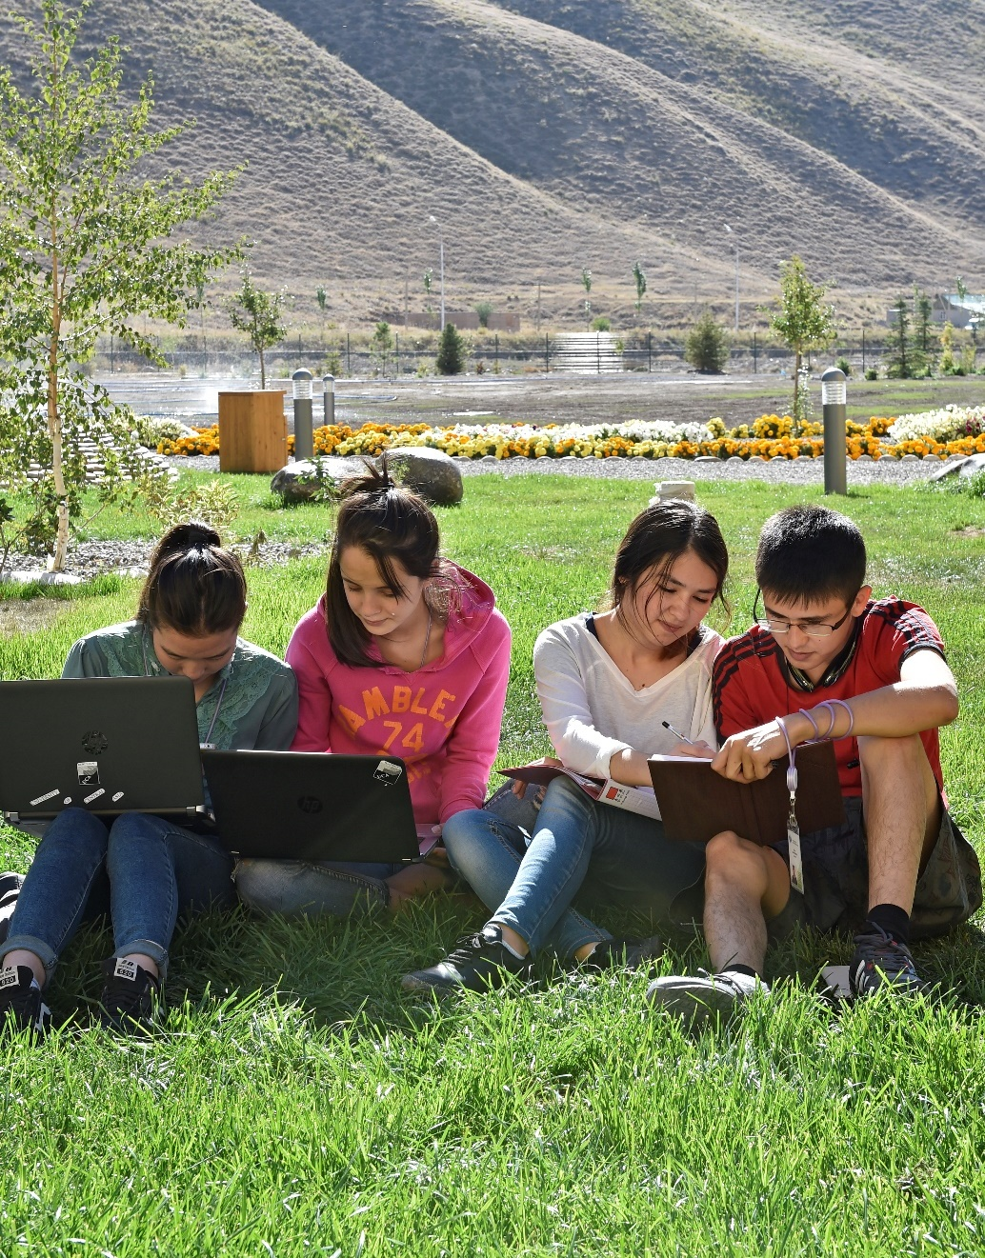
UCA Student Breakdown
By gender
50% Female
50% Male
By geographic area
33% Urban Centres
67% Small Towns and Rural Areas
8
Notes:
Information in this report may be useful for him.

Slide 9
Academic Block
9

Slide 10
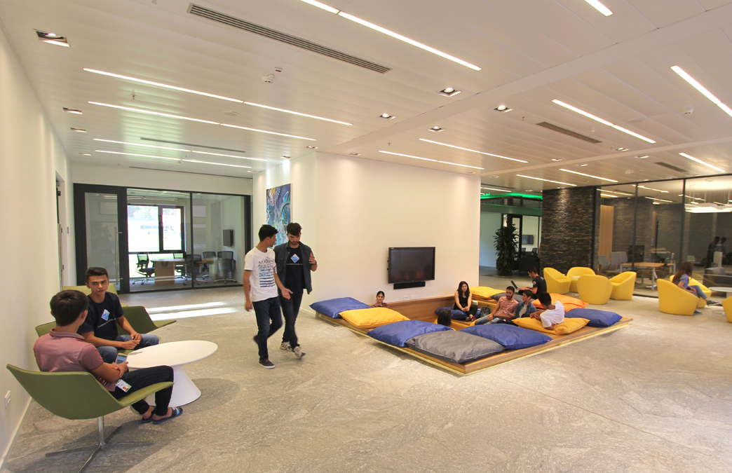
Academic Block
10

Slide 11
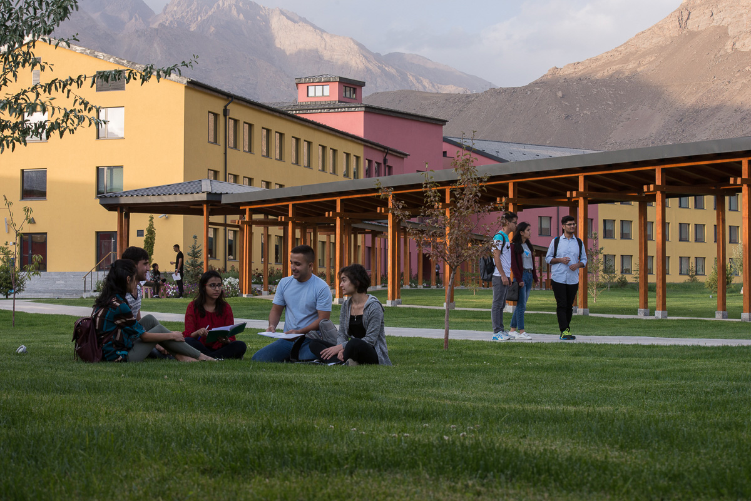
Outdoor Social Space
11

Slide 12
Flexible Classroom
12

Slide 13
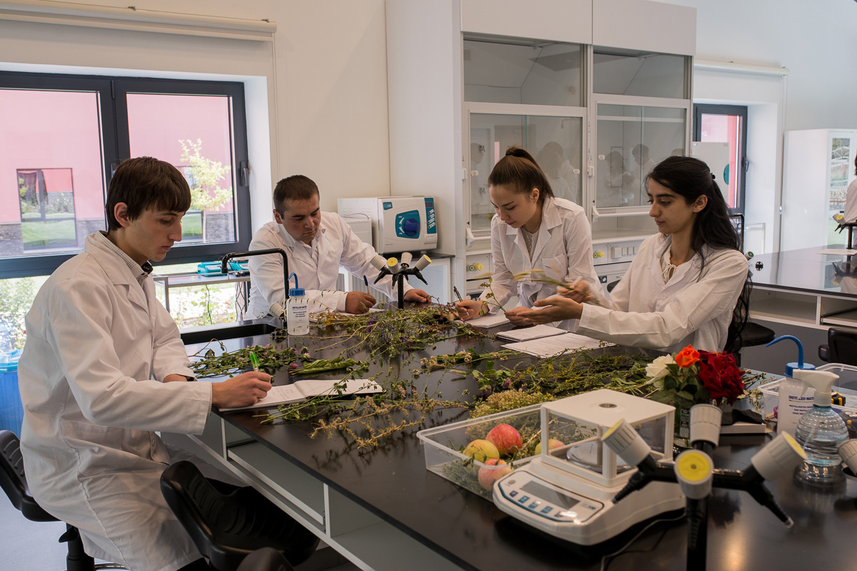
Science Class
13

Slide 14
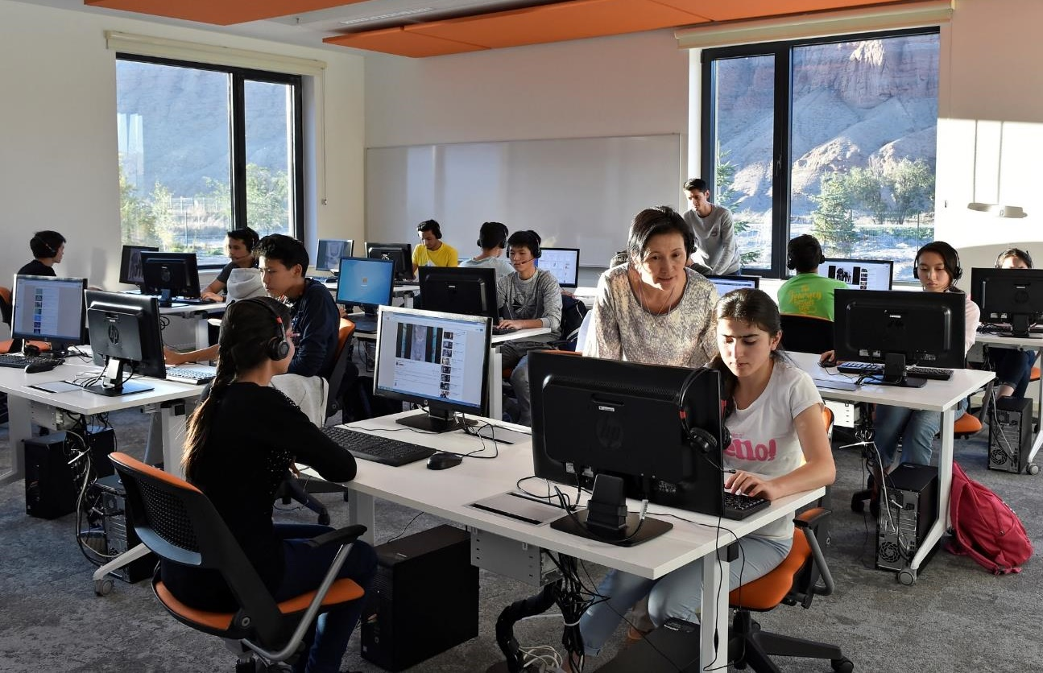
Computer Lab
14

Slide 15
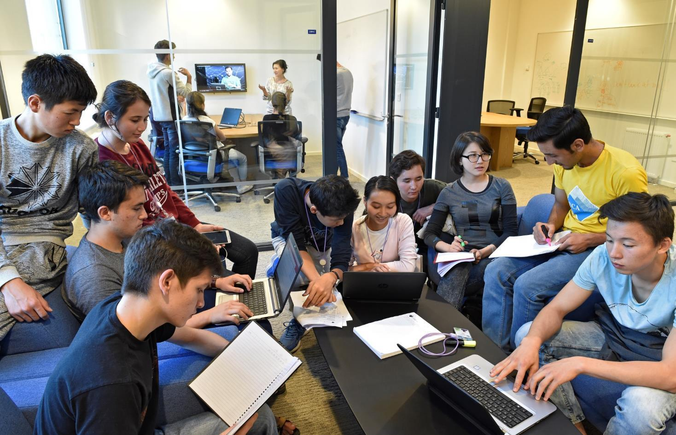
Student Spaces
15

Slide 16
Library
16

Slide 17
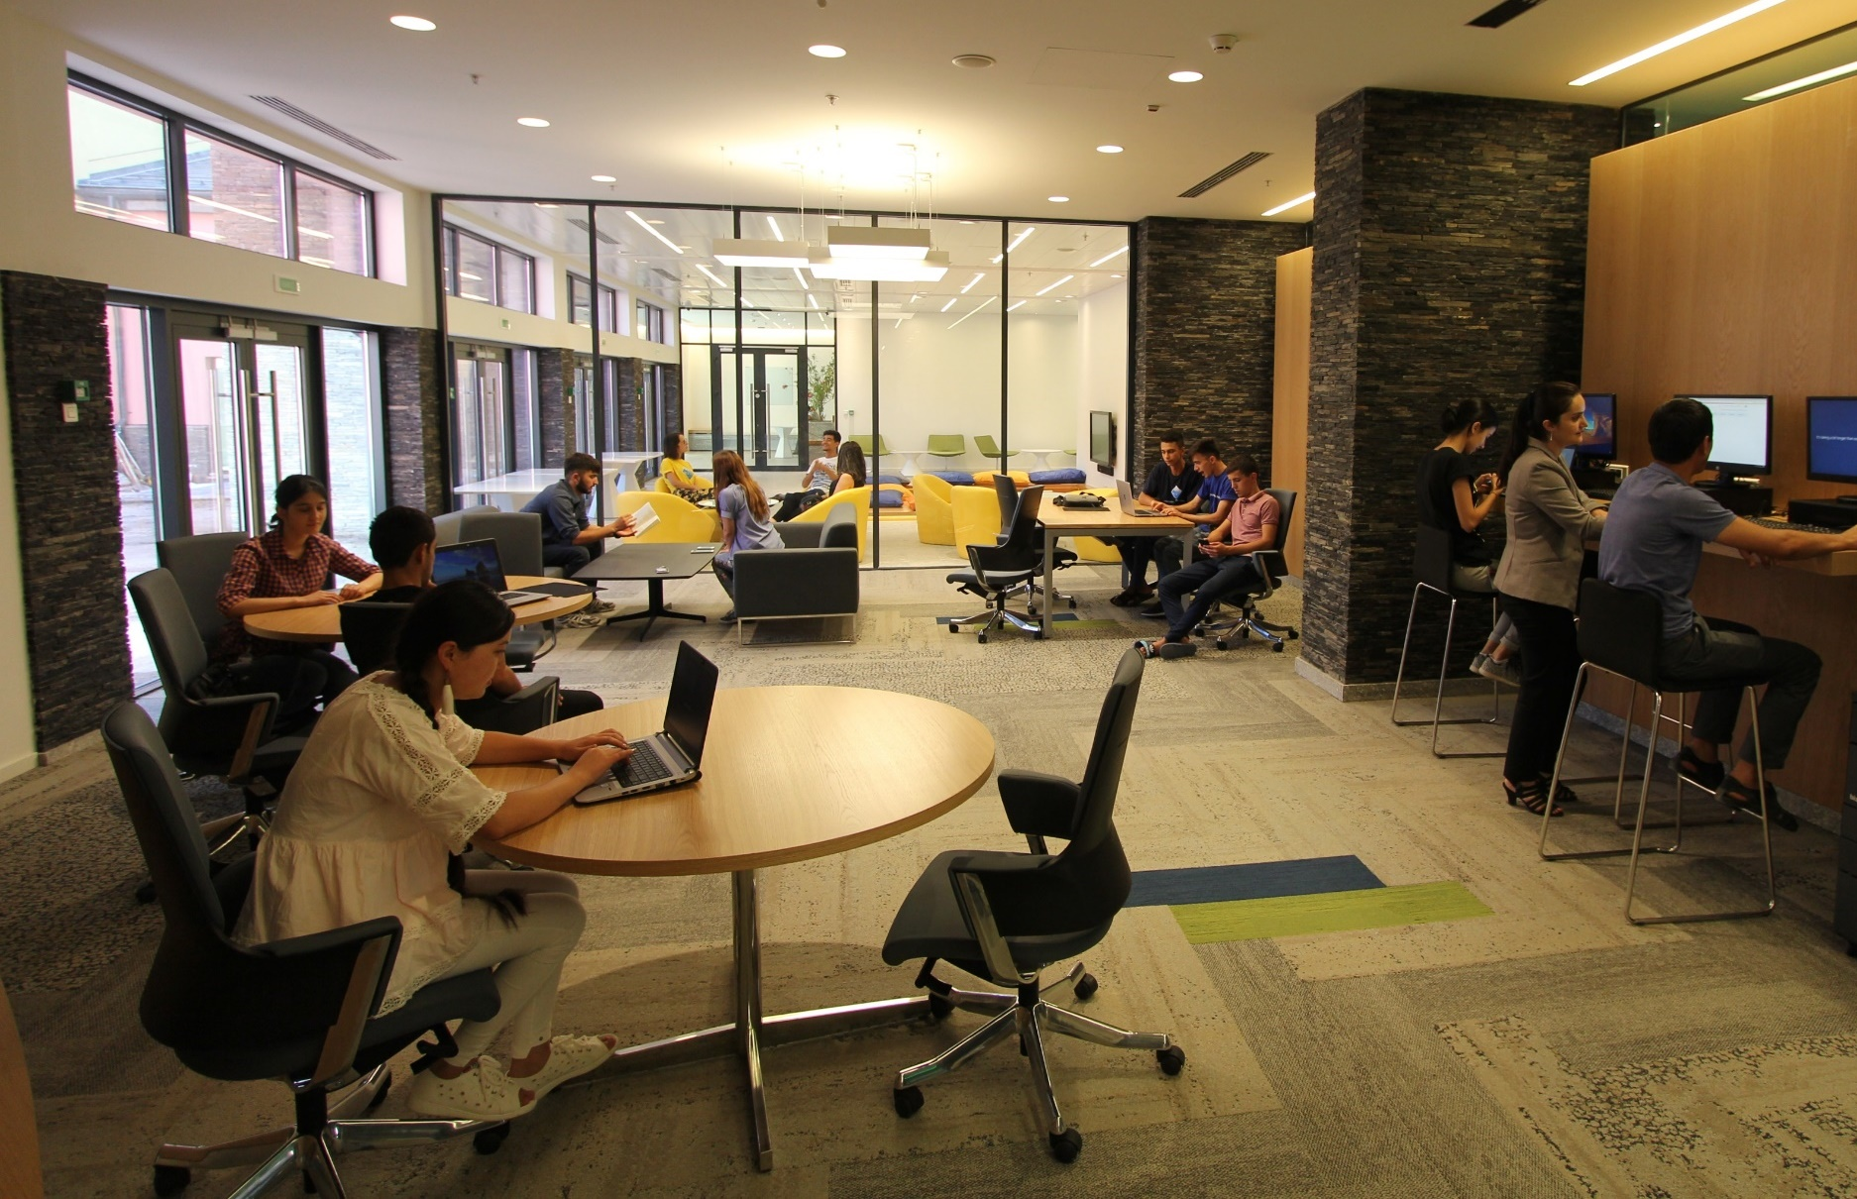
Library
17

Slide 18
Student Dormitory
18
Notes:
Student centered pro

Slide 19
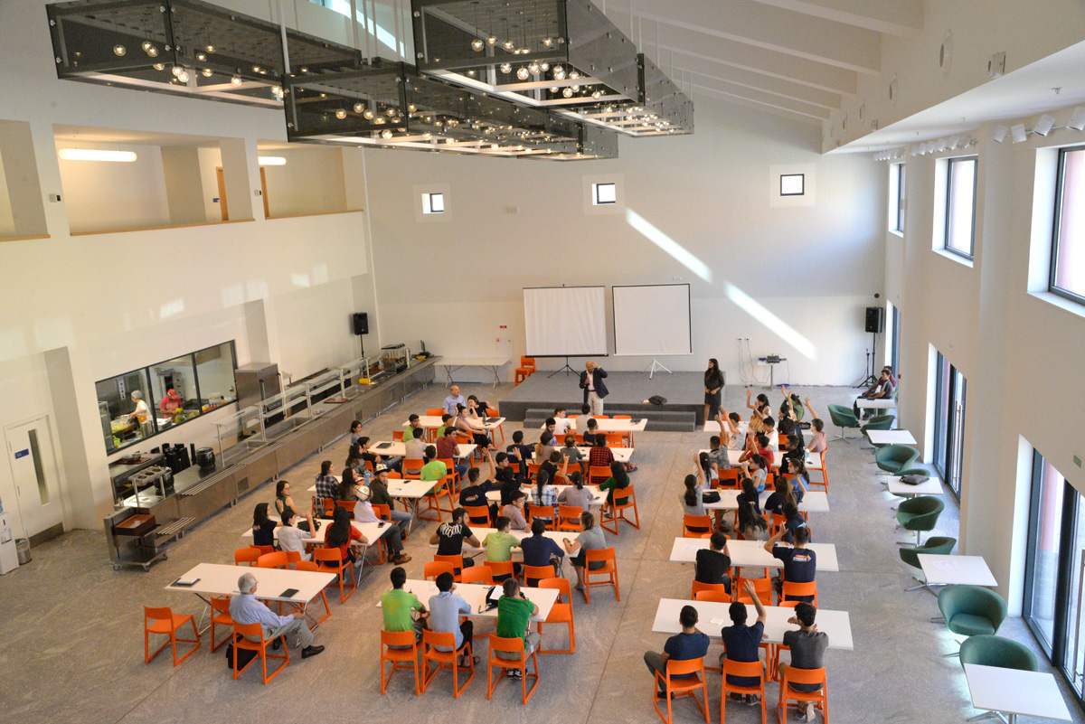
Dining Hall
19

Slide 20
Student Lounge
20

Slide 21
Sports Bubble
21

Slide 22
UCA Academic Partnerships
University of Toronto | Computer Science
University of British Columbia | Earth and Environmental Sciences
University of Victoria | Cooperative Education
Seneca College | Preparatory Programme
22

Slide 23
UCA Academic Partnerships
Higher School of Economics, Moscow | Economics
Stockholm School of Economics, Riga | Economics
University of Technology Sydney | Communications and Media
University of Cambridge | Faculty Development Programme
23

Slide 24
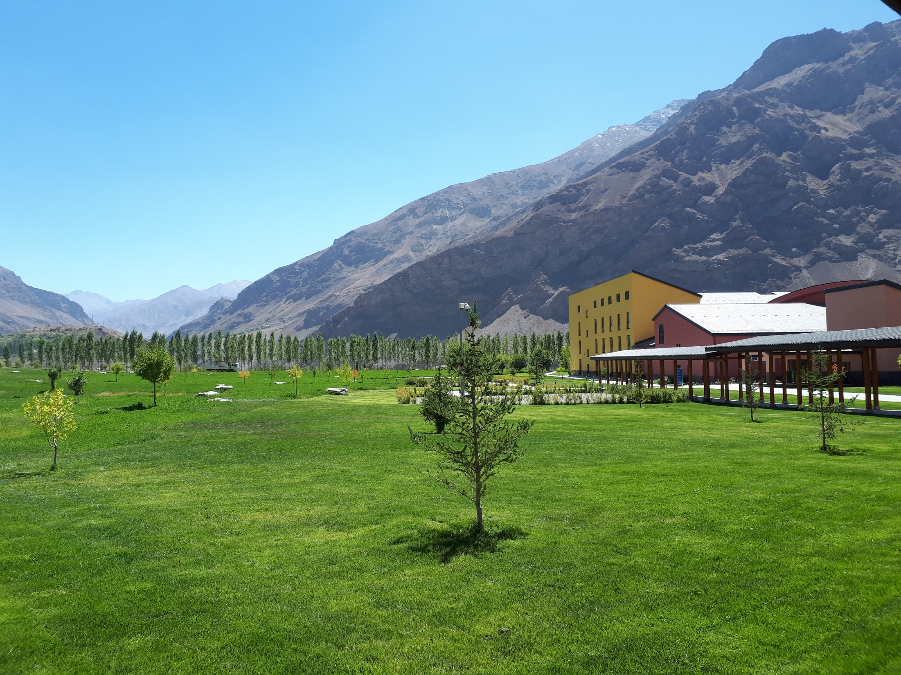
Co-operative Education Program
Notes:
The Co-operative Education Program is a work integrated learning program where students apply in-class learning to real life professional experiences within the field of study across private, public, and community-based sectors. This program prepares students for both academic and career success beyond university. UCA’s Co-op Program has been developed in partnership with the University of Victoria, Canada.
The major characteristics of a Co-operative education program include (1) a sequence of work and academic periods, (2) monetary compensation for the work done, which maintains both employer and student engagement, (3) an evaluation of the student’s and employer’s performance over the course of the work term; and (4) faculty engagement in the cooperative education program. In cooperative education programs, the work of the student is supervised by an employer and monitored by the academic institution.

Slide 25
WHAT is Co-op?
Co-operative education:
Experiential learning that gives the student a learning experience outside of the school environment at a workplace.
It gives hands-on experience in a field of studies and interest of a student.

Slide 26
UCA Co-op Partner
The University of Victoria was one of the first Canadian universities to initiate a co-op program, launching its first program in
1975

Slide 27
HOW it works?
Prep Year,
Co-op term = 0 credits
UG Year 1,
Co-op term = 2 credits
UG Year 2, Co-op term = 2 credits
UG Year 3,
Co-op term = 2 credits
Co-op is part of the academic program!
Diploma with Co-op Designation

Slide 28
HOW it works?
Co-op Workshop Series
(9 workshops December - April)
Job application period
(January – March)
Selection and Interview process
(March – April)
Co-op term
(May – July)

Slide 29
Benefits of Co-operative Education
Co-operative education is the bridge between the employer, the student and the academic institution and benefits everyone involved

Slide 30
Benefits of Co-operative Education for Students
Learn how to apply knowledge in “real world”
Get hands-on experience in your field of study
Establish relationship with employer & co-workers
Build the resume & make students more marketable
Earn money
Potential of getting a job right after or even before graduation
Potential to work with multiple employers over time
Identify your ideal working style and the type of job you want after graduating

Slide 31
Benefits of Co-operative Education for Employers
Access to talented and highly motivated students
Students bring new ideas, fresh perspectives and enthusiasm to the workplace.
Employers can utilize students for short term projects and needs without long term employment commitments
Employers are further able to assess student performance for future recruiting needs and create a pool of potential hires
Develop the leadership potential of existing staff
Co-op students require fewer training costs and become productive very quickly after starting full time employment.
Receive support and assistance from university co-op program staff

Slide 32
Benefits of Co-operative Education for University
Co-op programs attracts top quality, superior, well-motivated students.
Produces high quality students with a well-rounded education which build the institution’s reputation
Visibility and reputation through interactions with the community
Practical feedback on the quality and relevance of its academic programs from the professional community
Information on current research and development in employer sectors
Be informed on the needs of current job market

Slide 33
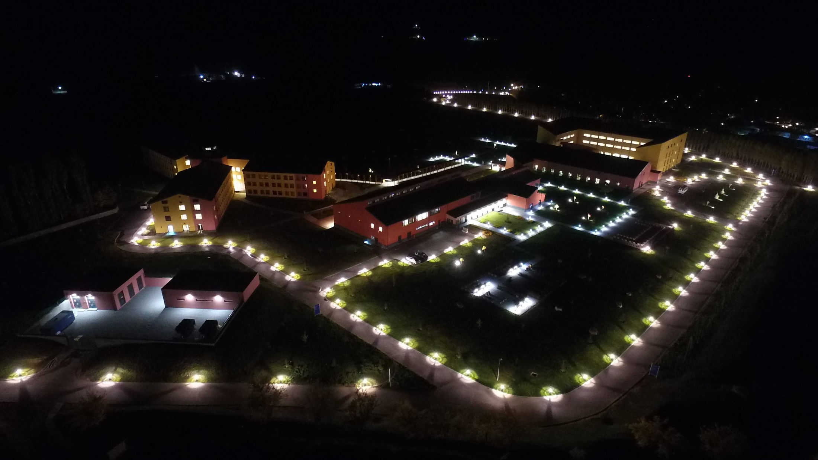
33

