Slide 1
English is the language of the international communication
WHY IS ENGLISH SO POPULAR?

Slide 2









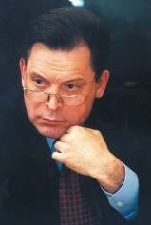


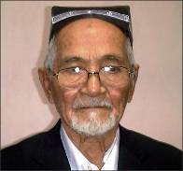



English – the language of the world

Slide 3
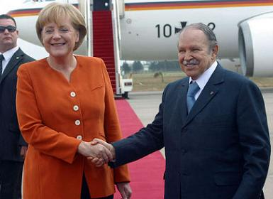
With what phrase is the conversation started
between two people that speak different
languages and want to find a common language?
Do you speak English?
Yes I do.

Slide 4
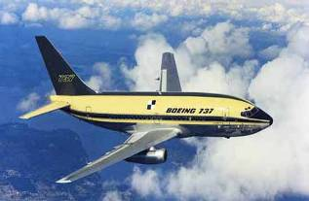


Different people learn foreign languages for different reasons. Some people take foreign languages out of snobbery. People of this type are snobs by nature and the very knowledge of a foreign language makes them feel superior to other people . Such people learn languages because it is fashionable.

Slide 5
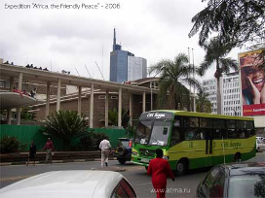
For other people learning a foreign language is a hobby.
Some people learn foreign language because they are fond of the culture, history or geography of this or that country. A knowledge of the language gives them tremendous pleasure.
English is very important to find a good job.

Slide 6
ENGLISH IS THE
LANGUAGE OF
AMERICA.

Slide 7
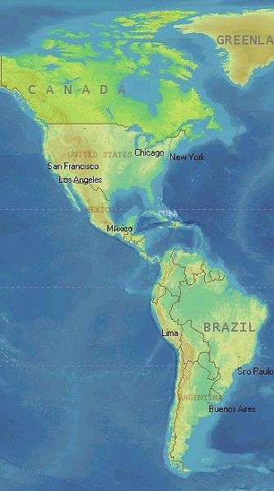
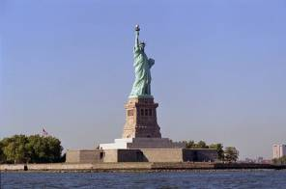
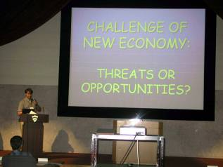
One of the biggest and strongest countries in the world
To do business with America

Slide 8
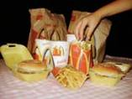


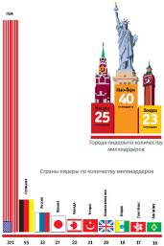

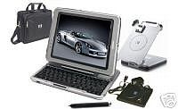
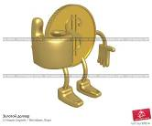
American restaurants
Hollywood
6 out of 10 richest people
American jeans
Science and technology
Dollar

Slide 9
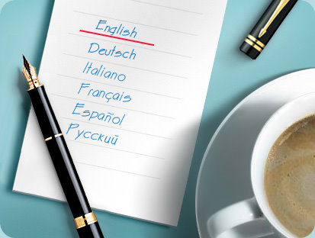
It is like many European languages and that's why people can learn it easily.

Slide 10
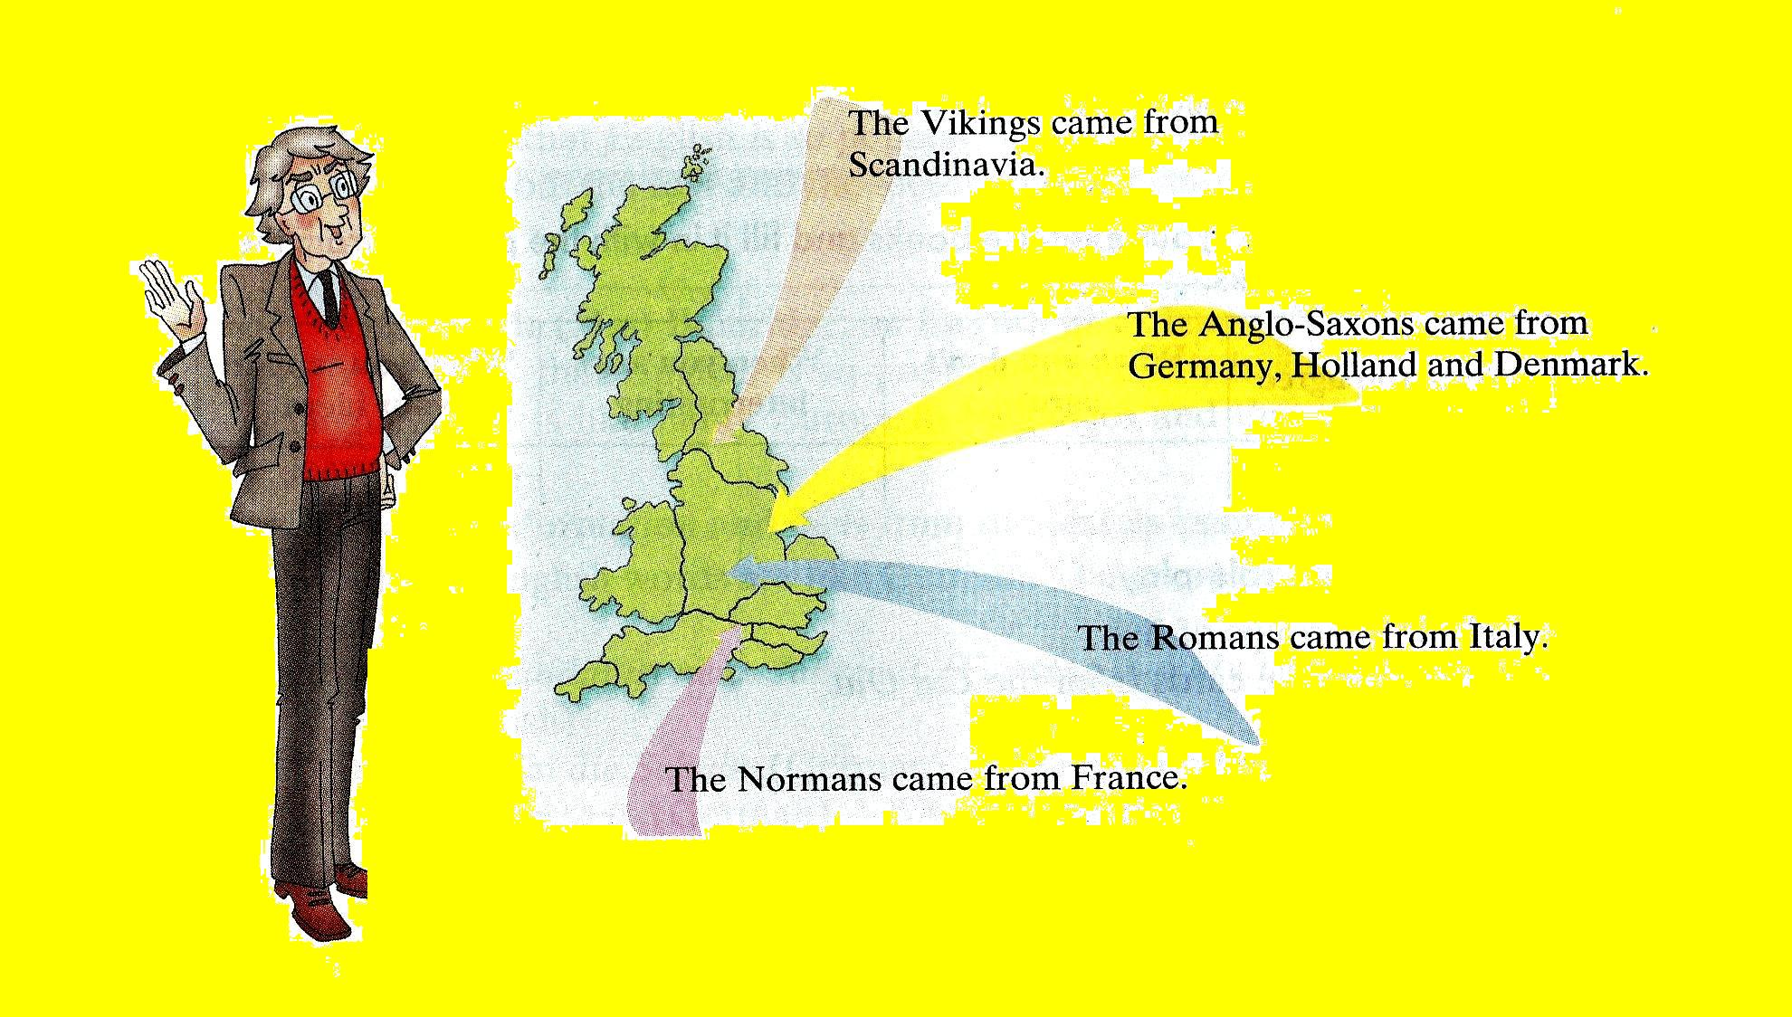
The roots of the English language
English is a Germanic language. The Anglo-Saxons contributed to the formation of English most of all. The English alphabet came from Latin. Christian monks, who spoke Latin, brought it to England from Ireland. It is very strange, but the Celtic language didn't contribute many words to modern English. We can only find Celtic words in the names of places and rivers such as: Dover, Kent, Avon and the Thames, for example.

Slide 11
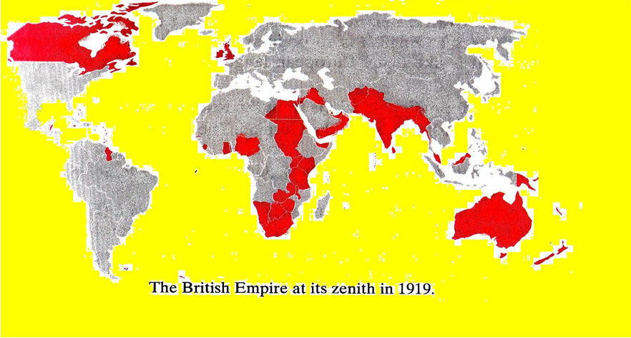
English is so popular because the United Kingdom used to be a big empire. The British had colonies all over the world, and all the people in the colonies had to speak English.

Slide 12

WHY IS ENGLISH SO POPULAR?
English is the language of America.
English is easy.
It has words from other languages.
The United Kingdom used to be a big empire.

Slide 13
LEARNING ENGLISH
Work on your English
as often as you can.
ENGLISH

Slide 14
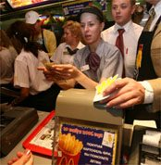

LEARNING ENGLISH
You should read English newspapers or books

Slide 15

LEARNING ENGLISH
Start a vocabulary notebook

Slide 16
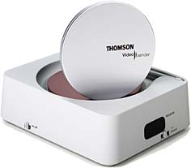
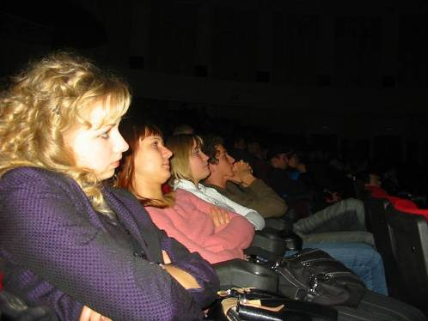
LEARNING ENGLISH
Watch films in English

Slide 17

LEARNING ENGLISH
Listen to English cassettes

Slide 18



LEARNING ENGLISH
Learn a lot of grammar rules by heart

Slide 19
LEARNING ENGLISH
Learn texts and songs

Slide 20
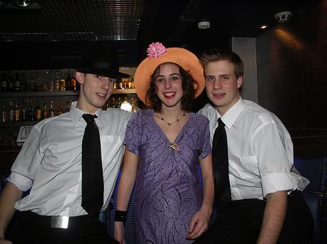
It is the world’s top tongue
One billion people speak English. That’s 20% of the world population

Slide 21

The English language is now the first language of about 750 million people, the native language of 12 nations and the official or semiofficial language of 33 more nations. That means one in every seven people in the world speaks English.

Slide 22

It is the standard language for communication
80% of all information in the computers’ world is in English.75% of all international letters and telexes are in English.

Slide 23

50% of all the companies in Europe communicate with one another in English

Slide 24

More than half of the world's periodicals are printed in English

Slide 25
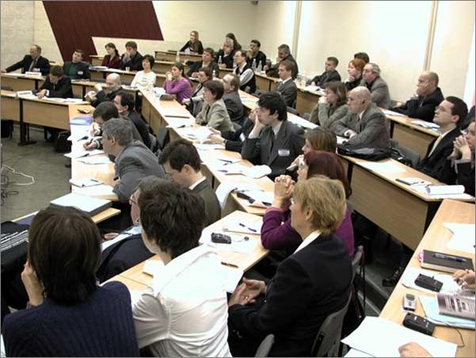
It is international for:
Businesspeople
Pilots
Diplomats
Politicians
Scientists
Sportsmen
Musicians
Students

Slide 26

It is a global language nowadays
Problems of the 21st century, such as the problems of war and peace, ecology, demographics, democracy and many others can not be solved if people do not speak the same language.

Slide 27

If you know English,you’ll get access to the Internet

Slide 28


